Slide 1
Deepfake Detection Using Binary Neural Network
Ali Sabet - b00087958
Mohammad Yaser Azrak - b00090174
Abdullah Shahid - b00092449
Adithya Krishnakumar - b00091171

Slide 2
Introduction
Problem:
Detection of deep fakes: AI-generated or altered images/videos of real or fake individuals.
Deepfake technology is advancing and becoming more accessible.
Increasing risk of misleading content that appears realistic.
Challenge:
Mitigating misinformation resulting from images or videos that are becoming increasingly distinguishable from reality.

Slide 3
Problem Statement
The rapid advancement and accessibility of deepfake technology have made it increasingly difficult to distinguish between real and manipulated content. This has led to significant challenges in combating the spread of misinformation and privacy violations. Existing methods for detecting deepfakes often struggle to keep pace with the ever changing technologies. There is a pressing need for effective and robust solutions that leverage state-of-the-art computer vision techniques to identify subtle artifacts and discrepancies in deepfake media.

Slide 4
Literature Review
Join the High Accuracy Club on ImageNet with A Binary Neural Network Ticket
Introduces BNext, a binary neural network with Info-RCP and ELM-Attention modules.
Achieved 80.57% accuracy on ImageNet, the first BNN to cross 80%.
Multi-task Learning For Detecting and Segmenting Manipulated Facial Images and Videos
Uses CNN to detect and segment areas in an image that were manipulated. Accuracy = 93.63%.
FaceForensics++ Learning to Detect Manipulated Facial Images
Used the XceptionNet model to achieve a classification accuracy of 99.26%
Frequency-Aware Deepfake Detection: Improving Generalizability through Frequency Space Domain Learning
FreqNet achieves a 9.8% higher mean accuracy compared to existing methods
Leverages high-frequency features in the frequency domain.
KoDF: A Large-scale Korean DeepFake Detection Dataset
Training the model with KoDF improved testing accuracy and recognition rate by 3.09%.

Slide 5
Methodology
Data Ingestion
The train set uses torchvision.transforms.Compose to preprocess images, including normalization and augmentation​.
The test data is also similarly normalized to maintain consistency between training and testing phases​.
Data Augmentation
Various transformations are applied during the training process:
Random horizontal flipping, rotation, and color jittering for brightness, contrast, saturation, and hue are implemented​.
Deep Learning Model
A custom model BNext is implemented by one of the papers, which we are using. It defines multiple convolutional layers, adaptive pooling, and classification layers, tailored for different configurations (e.g., "tiny," "small")​.
The model incorporates specialized components like Attention, SqueezeAndExpand, and FFN_1x1, demonstrating a detailed architectural design.
Performance Metrics for Evaluation
During training, loss metrics (Cross Entropy) are computed​.
Metrics such as accuracy, precision, recall, and F1-score are calculated to evaluate model performance on test data​.

Slide 6
Implementation
Adam optimization with a learning rate of 0.001
Cross Entropy Loss
Batch size: 32
10 Epochs
Architecture: BNext architecture.
BNext architecture is an advanced Binary Neural Network achieving higher accuracy than conventional binary neural networks.

Slide 7
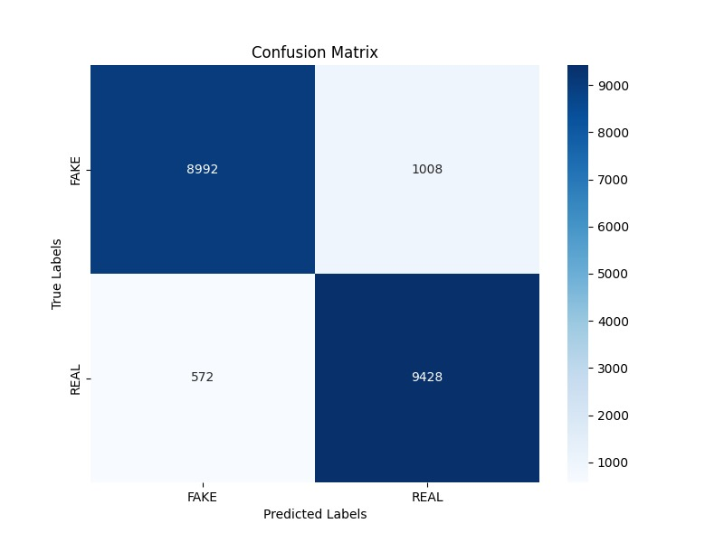
Results
Test Accuracy | 90.6%
Precision | 90.0%
Recall | 91.0%
F1 Score | 91.0%

Slide 8
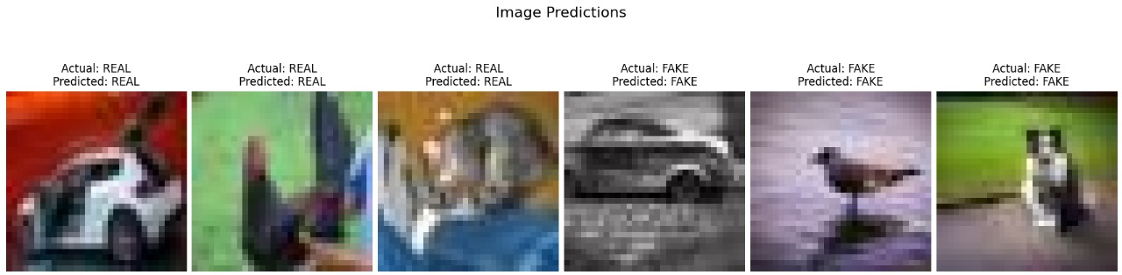
Performance Evaluation

Slide 9
Discussion
Our model is lightweight compared to other models, resulting in fewer parameters to train.
The metrics achieved by our model are competitive with state-of-the-art deepfake detection methods.
Differences between our implementation and the paper:
Paper uses the KL Divergence Loss whereas we used the Cross Entropy Loss

Slide 10
Work Division
Abdullah | Adithya | Ali | Yaser
Literature Review and dataset | Literature Review and dataset | Literature Review and introduction | Literature review and objectives
Presentation, code development | Code development, model testing and evaluation, presentation | Code development, GitHub organization, model training and testing | Code development, GitHub organization, model training, presentation

Slide 11
Demonstration
Live demo in class - The recorded video is on GitHub

Slide 12
THANK YOU!

Slide 13
References
[1] N. Guo, J. Bethge, C. Meinel, and H. Yang, “Join the High Accuracy Club on ImageNet with A Binary Neural Network Ticket,” arXiv.org, 2022. https://arxiv.org/abs/2211.12933
[2] H. H. Nguyen, F. Fang, J. Yamagishi, and I. Echizen, “Multi-task Learning For Detecting and Segmenting Manipulated Facial Images and Videos,” arxiv.org, Jun. 2019, Available: https://arxiv.org/abs/1906.06876
[3] A. Rössler, D. Cozzolino, L. Verdoliva, C. Riess, J. Thies, and M. Nießner, “FaceForensics++: Learning to Detect Manipulated Facial Images,” arXiv:1901.08971 [cs], Aug. 2019, Available: https://arxiv.org/abs/1901.08971
[4] C. Tan, Y. Zhao, S. Wei, G. Gu, P. Liu, and Y. Wei, "Frequency-Aware Deepfake Detection: Improving Generalizability through Frequency Space Domain Learning," in Proceedings of the AAAI Conference on Artificial Intelligence, vol. 38, no. 5, pp. 5052-5060, Mar. 2024, doi: 10.1609/aaai.v38i5.28310
[5] P. Kwon, J. You, G. Nam, S. Park, and G. Chae, “KoDF: A Large-scale Korean DeepFake Detection Dataset,” arXiv (Cornell University), Mar. 2021, doi: https://doi.org/10.48550/arxiv.2103.10094

